Slide 1

DXC REAL TIME PROJECT
Presented by,
Mahalakshmi S
DXC262AB1229

Slide 2

CONTENTS
PROJECT 1
CONNECTED VEHICLES
PROJECT 2
AP MORGAN DATA PLATFORM

Slide 3
PROJECT 1
TOPIC:
CONNECTED VEHICLES
TARGET:
Moving data from staging to SQL DB using
pipelines.

Slide 4
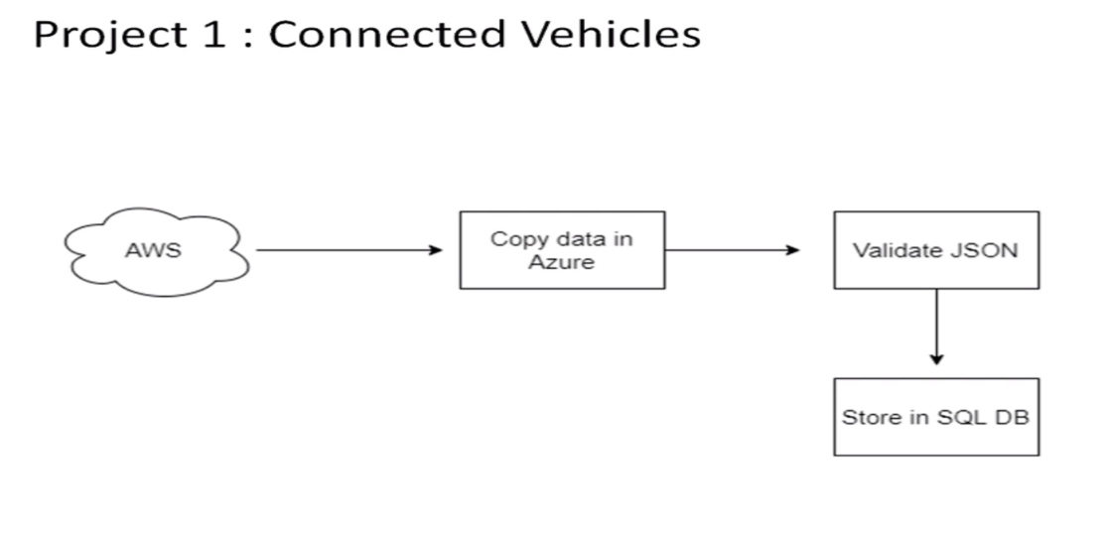
PROJECT ARCHITECTURE
CONNECTED VEHICLES
General motors is one of the leading heavy vehicles
manufacture company. To improve their services they
are planning to roll out IOT new features based on IOT

Slide 5
PROJECT LABORATORY
Creating azure data factory
Creating Azure data factory pipeline
Creating blob trigger logic
Creating azure sql server and database
Adding another pipeline to move data from staging to sql database

Slide 6
AZURE RESOURCES
To finish this project we need the azure resources
Azure data factory
Azure storage account
Azure SQL database

Slide 7

AZURE DATA FACTORY:
What is Azure data factory?
Azure Data Factory is the platform that solves such data scenarios.
It is the cloud-based ETL (Extract, Transform, Load)and data integration service that allows you to create data-driven workflows for data movement and transforming data at scale.
Using Azure Data Factory, you can create and schedule data-driven workflows called pipelines.

Slide 8
CREATING DATA FACTORY
STEPS:
Azure account->Create resources->Data factory
Create->Review+create->validation successful ->deployment
successful->Go to resource

Slide 9
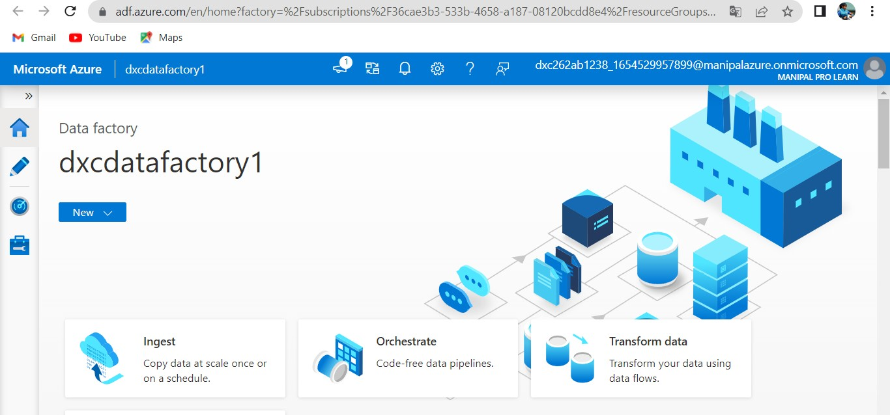

Slide 10

AZURE STORAGE ACCOUNT
What is azure storage account?
An Azure storage account contains all of your Azure Storage data objects, including blobs, file, shares, queues, tables, and disks.
The storage account provides a unique namespace for your Azure Storage data that's accessible from anywhere in the world over HTTP or HTTPS.
Data in your storage account is durable and highly available, secure, and massively scalable.

Slide 11
CREATING AZURE STORAGE ACCOUNT
STEPS:
Azure account-> Create resources-> Storage account-> Create-> Review+create-> validation successful-> deployment successful-> Go to resource

Slide 12
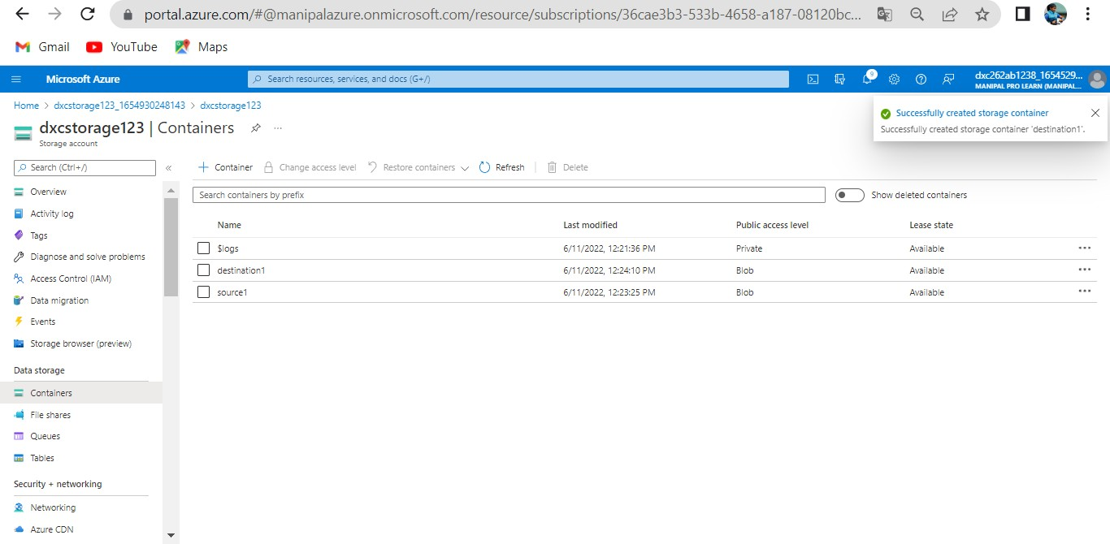

Slide 13
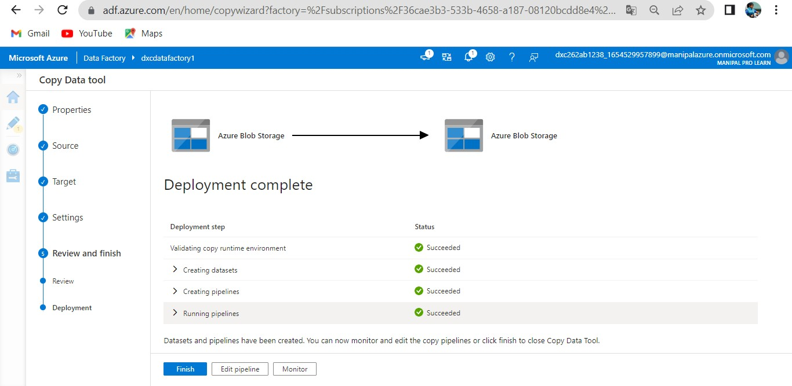
AZURE DATA FACTORY PIPELINE
A pipeline is a logical grouping of activities that performs a unit of work. Together, the activities in a pipeline perform a task.

Slide 14
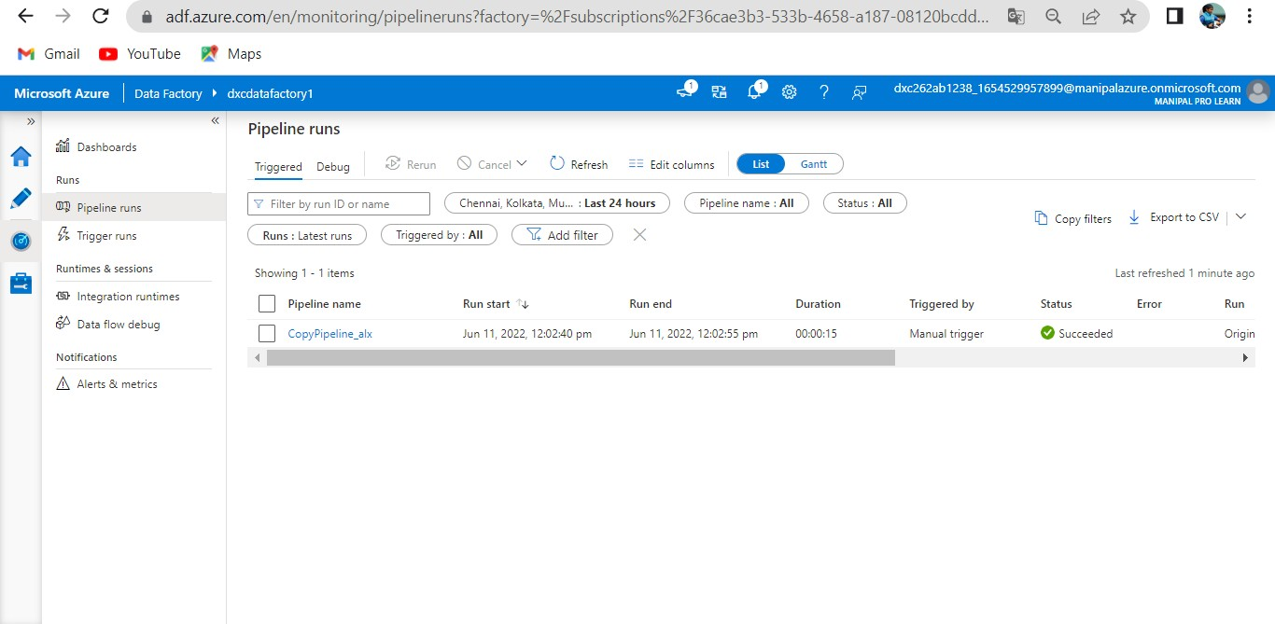
CREATING BLOB TRIGGER Trigger run successfully

Slide 15
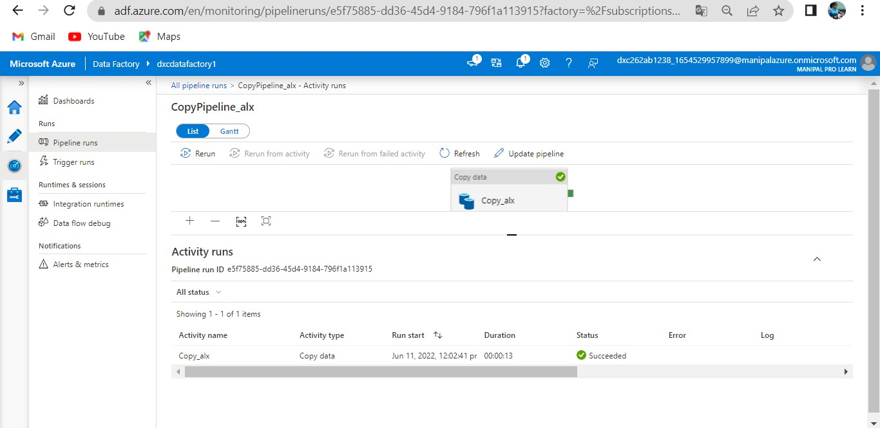
BLOB TRIGGER

Slide 16
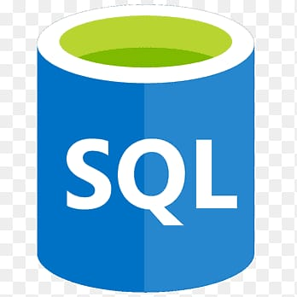
AZURE SQL DATABASE
What is azure sql database?
Azure SQL Database is a fully managed platform as a service (PaaS) database engine that handles most of the database management functions such as upgrading, patching, backups, and monitoring without user involvement.
With Azure SQL Database, you can create a highly available and high-performance data storage layer for the applications and solutions in Azure.

Slide 17
CREATING SQL DATABASE
STEPS:
Azure account-> Create resources-> Storage account-> Create-> server-> server name-> login credentials-> Review+create-> validation successful-> deployment successful-> Go to resource

Slide 18
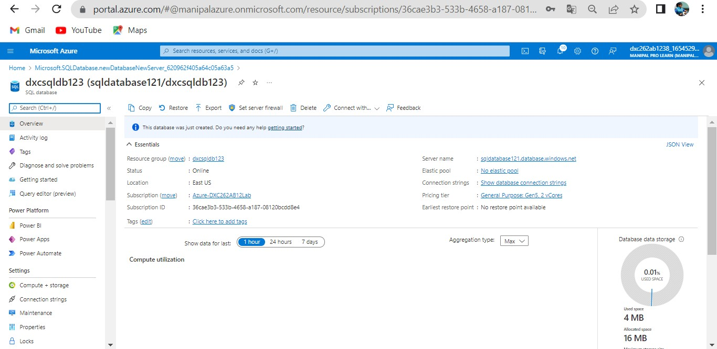

Slide 19
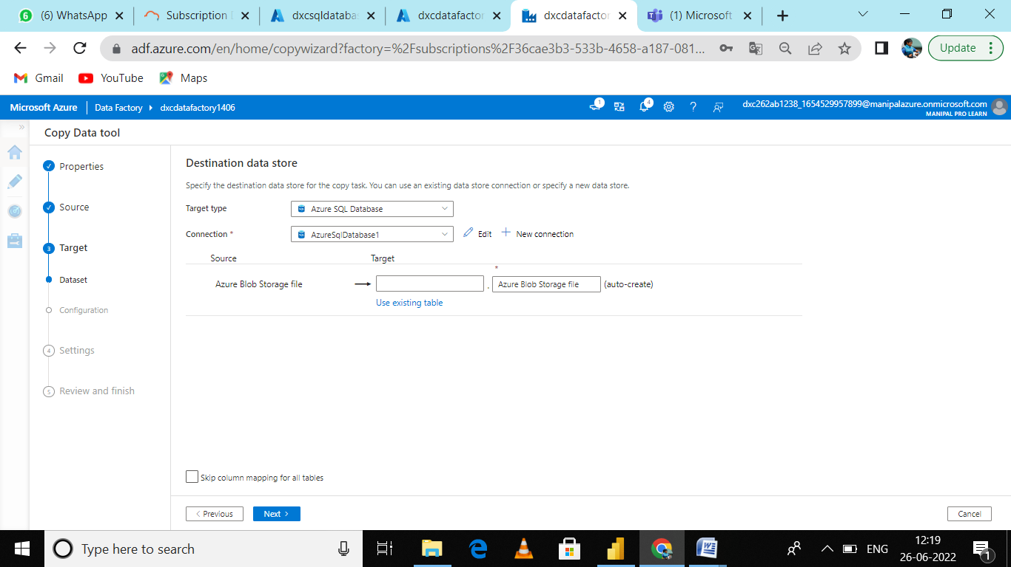
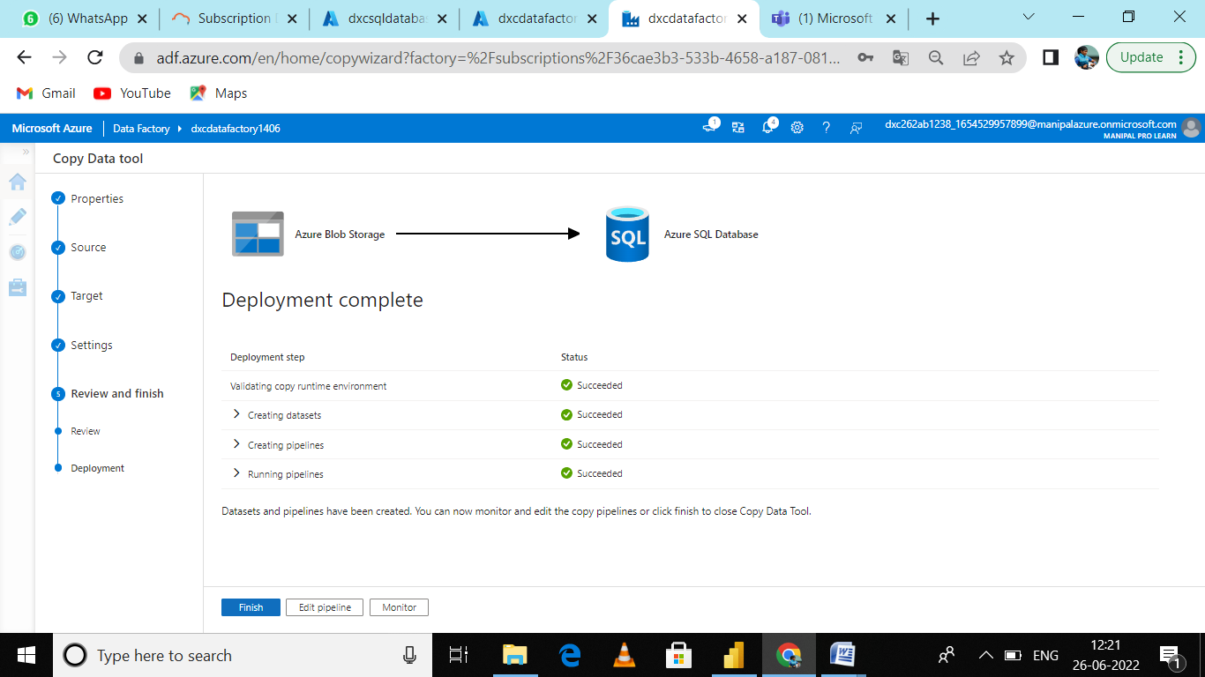
ANOTHER PIPELINE TO MOVE DATA FROM STAGING TO SQL DATABASE

Slide 20
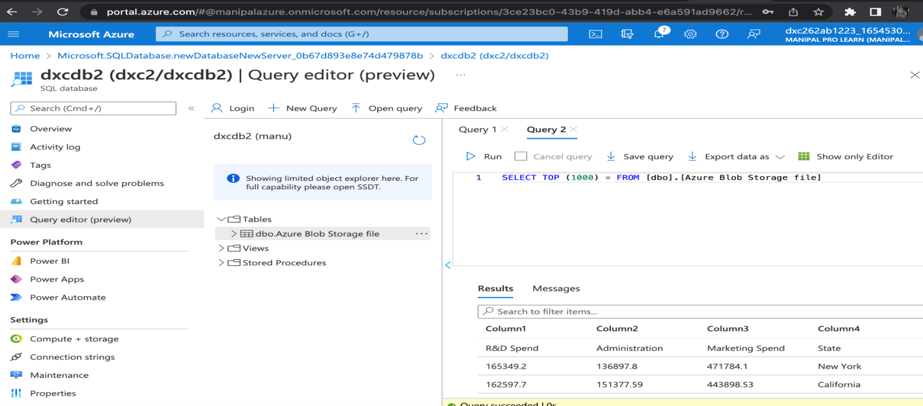
RESULT
In this project we are creating the pipeline successfully which will validate and copy the data in azure blob storage into the azure SQL database by using Azure Data Factory.

Slide 21
CONCLUSION
The blob data is created successfully and then validated and stored into SQL database.

Slide 22
PROJECT 2
TOPIC:
AP MORGAN DATA PLATFORM
TARGET:
To link azure data bricks in azure data factory

Slide 23
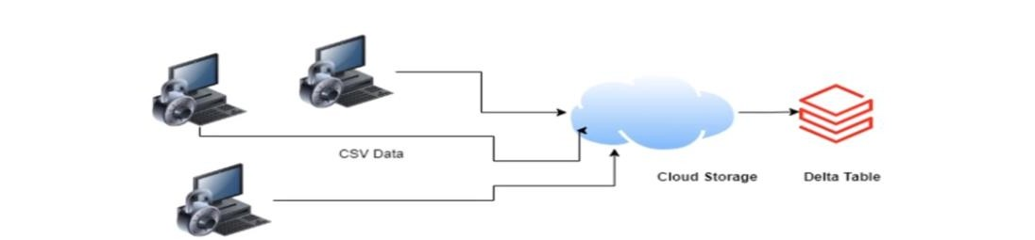
PROJECT ARCHITECTURE
AP MOGRAN DATA PLATFORM
Multiple internal applications sends the data in CSV format on daily basis in the cloud storage location. There are couple of data or scheme validation needed to be perform on the incoming data.

Slide 24
PROJECT LABORATORY
Create data bricks
Creating the cluster in data bricks
Adding notebook in data bricks and Implement BL
Creating data factory
Creating azure data bricks linked service in azure data factory

Slide 25
AZURE RESOURCES
To finish this project we required resources like,
AZURE DATA BRICKS
AZURE DATA FACTORY

Slide 26
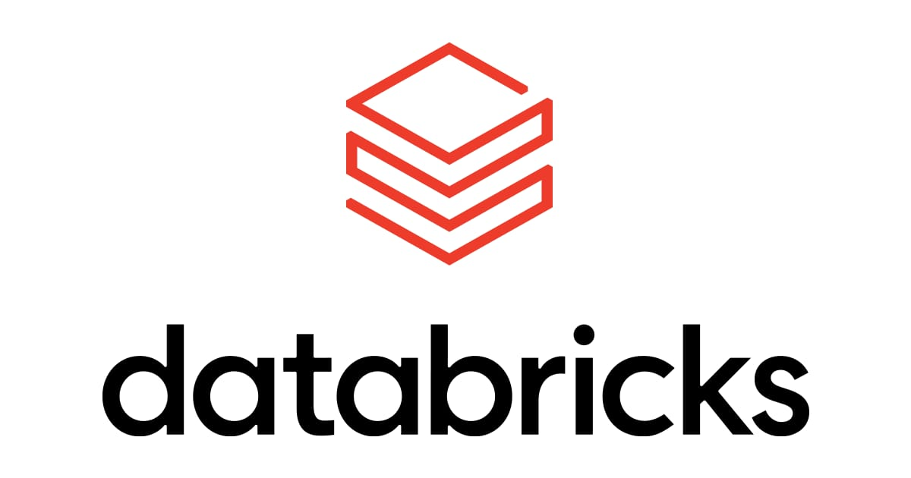
AZURE DATA BRICKS
Azure Databricks is an enterprise-grade and secure cloud-based big data and machine learning platform.
Databricks provides a notebook-oriented Apache Spark as-a-service workspace environment, making it easy to manage clusters and explore data interactively.

Slide 27
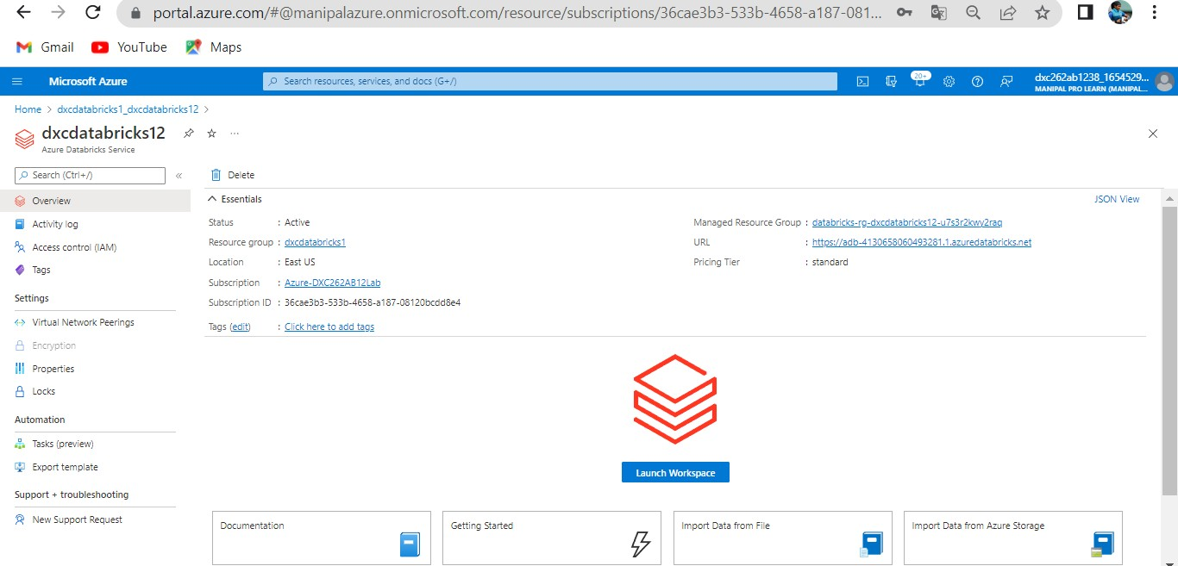
CREATING AZURE DATABRICKS Azure account-> Create resources-> databricks-> Create-> Review+create-> validation successful-> deployment successful-> Go to resource

Slide 28
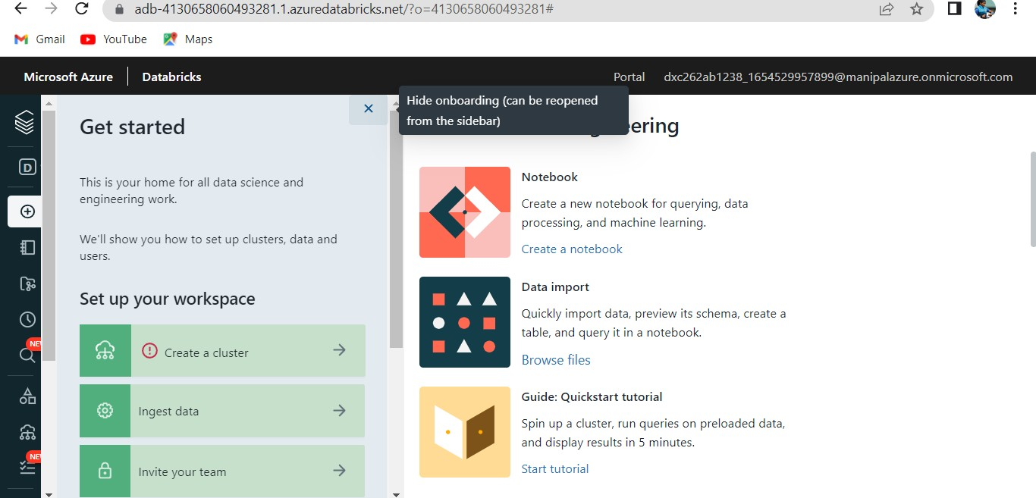
CREATING CLUSTER IN AZURE DATABRICKS

Slide 29
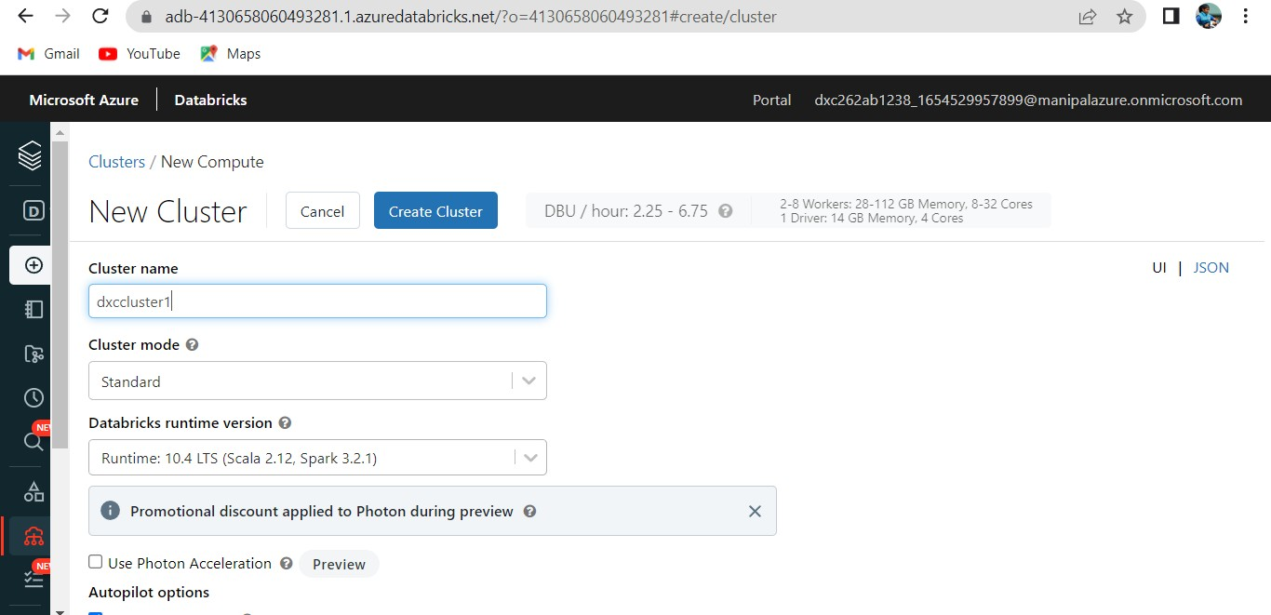
CREATING A NEW CLUSTER

Slide 30
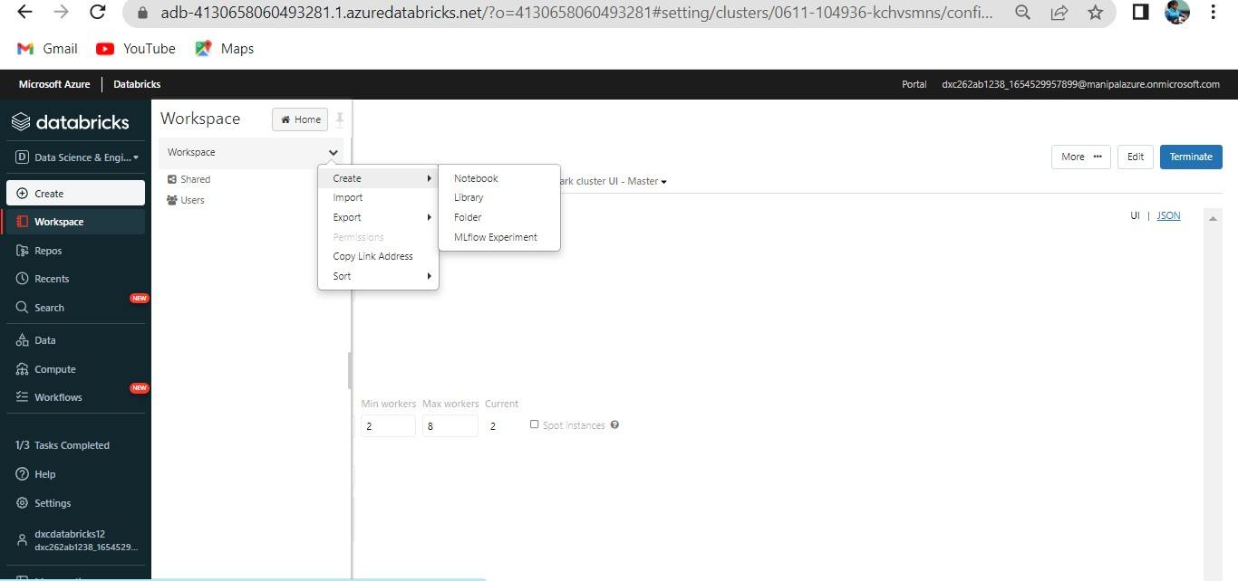
ADDING NOTEBOOK IN THE CLUSTER

Slide 31
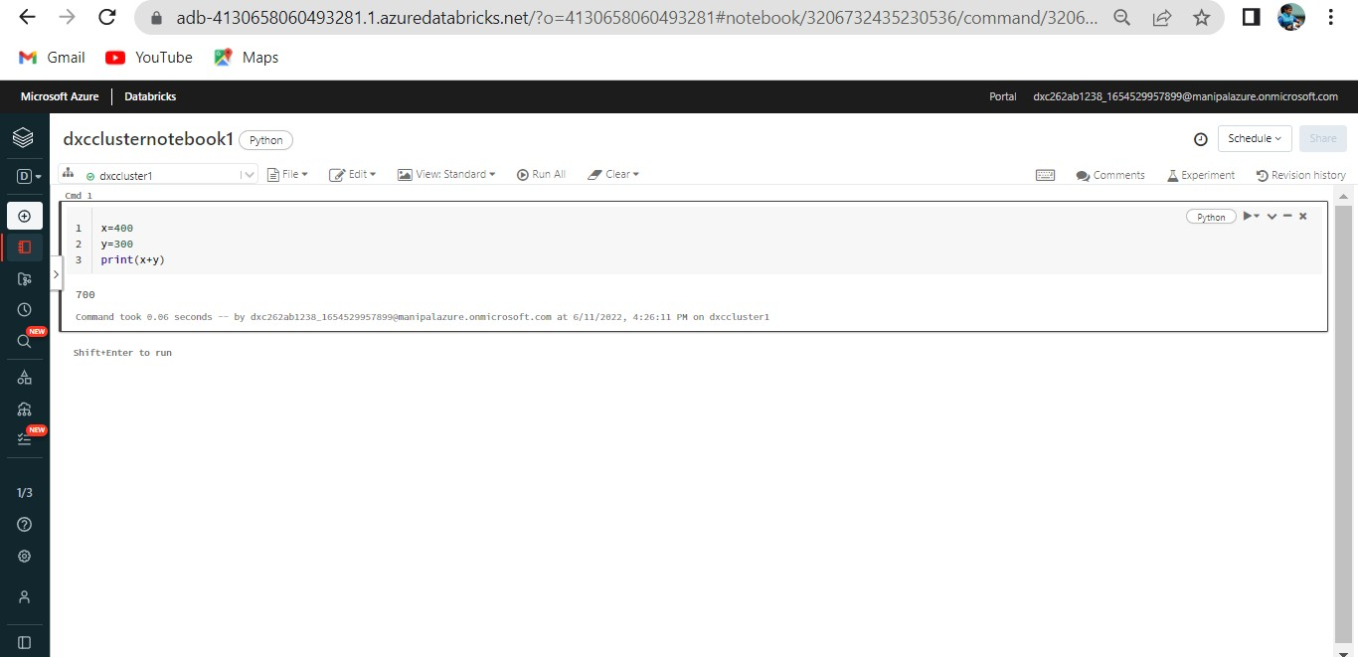
IMPLEMENTING BI IN THE NOTEBOOK

Slide 32
CREATING AZURE DATA FACTORY

Slide 33
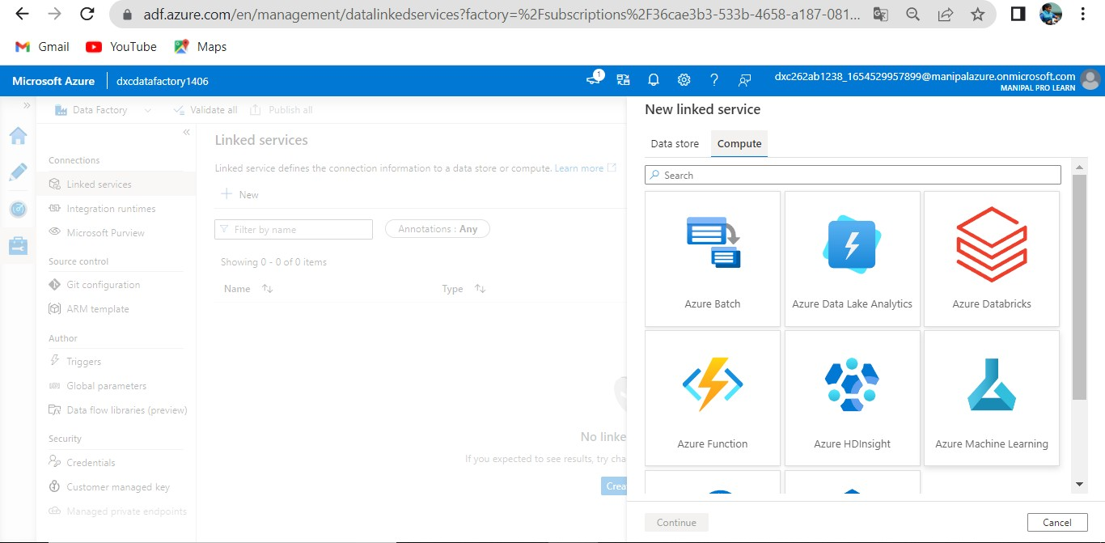
AZURE DATABRICKS LINKED SERVICE IN ADF

Slide 34
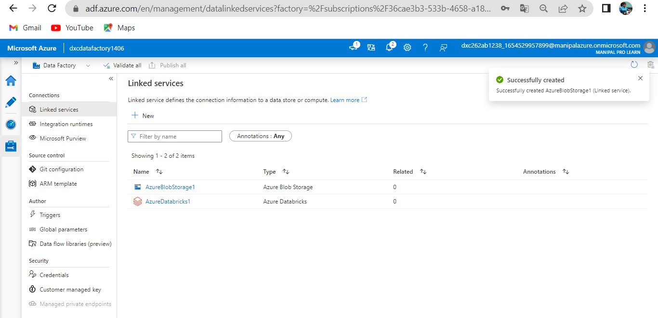
AZURE DATABRICKS IS SUCCESSFULLY LINKED IN ADF SERVICES

Slide 35
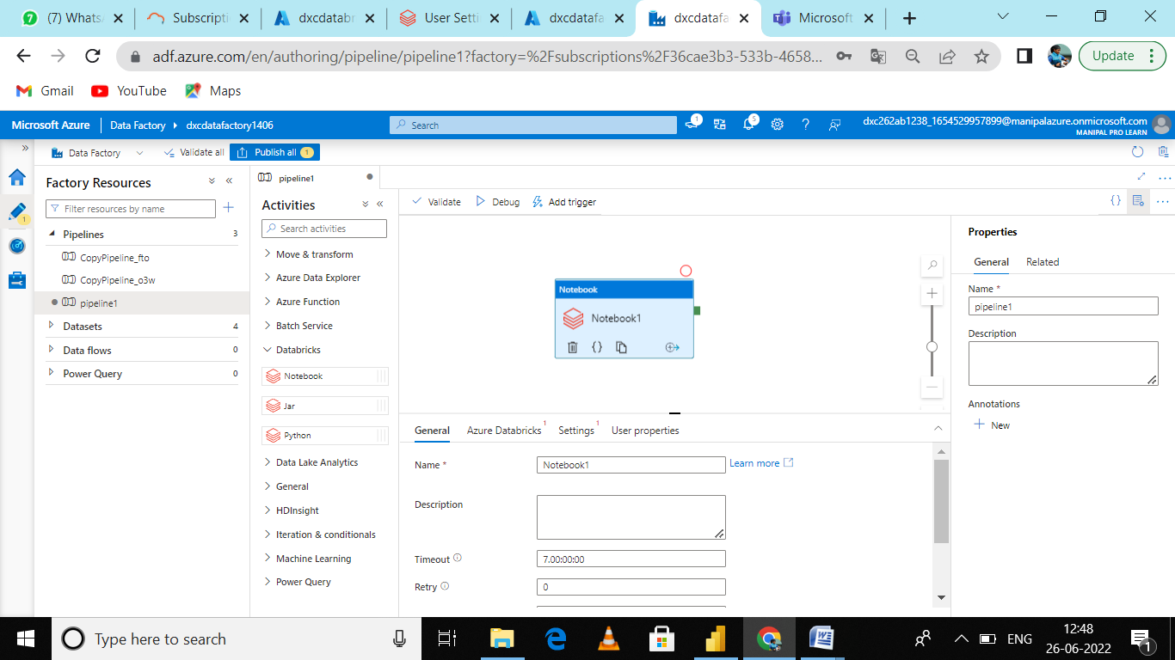
Create a pipeline
Insert the notebook tab from the Azure Data bricks drop down onto the workspace of the pipeline

Slide 36
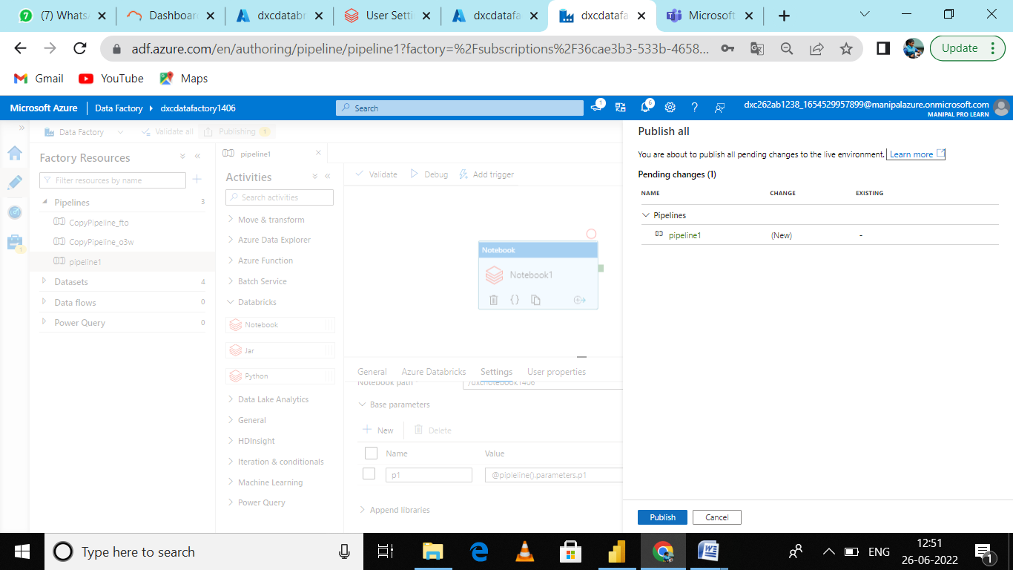
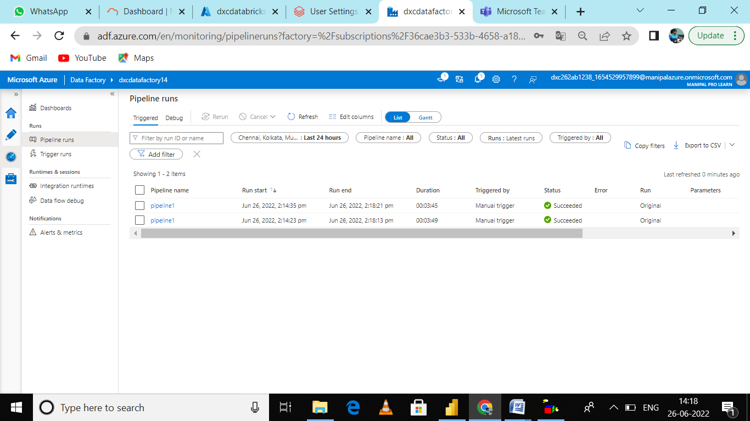
Trigger the pipeline and monitor the pipeline whether it runs successfully

Slide 37
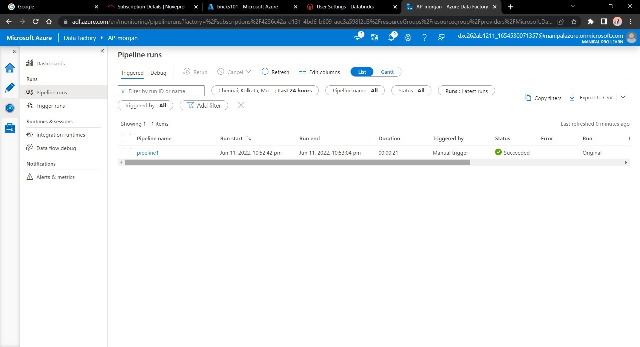
RESULT
Data Factory has successfully triggered a linked notebook of Data bricks.

Slide 38
CONCLUSION
In Azure Data bricks the operations like creation of cluster and notebook and linked services are performed successfully.

Slide 39


